Slide 1

White-Box Testing

Slide 2
Recall: Common ways to choose test cases
Black-box testing
White-box testing
Regression testing

Slide 3
White-Box Testing
Uses internal logic to choose tests
Different levels of code coverage
Example: Cover all statements
Aka glass box testing, clear box testing

Slide 4
Code Coverage
Degree to which source code of a program is tested by a test suite
Examples:
Statement coverage
Branch coverage
Path coverage
To compute these, you need…
Notes:
There are more types of coverages

Slide 5
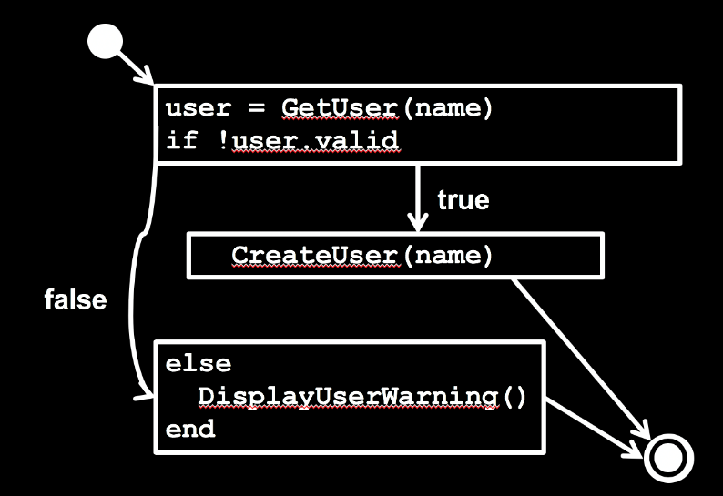
Control Flow Graph (CFG)
Represents possible control paths through code:
Given some code:
def Create(name)
user = GetUser(name)
if !user.valid
CreateUser(name)
else
DisplayUserWarning()
end
end

Slide 6
How to construct a CFG
Step 1: Identify basic blocks
Straight-line pieces of code without any branches
def Create(name)
user = GetUser(name)
if !user.valid
CreateUser(name)
else
DisplayUserWarning()
end
end

Slide 7
How to construct a CFG
Step 2: Model the jumps (control branches) as directed lines
user = GetUser(name)
if !user.valid
true
CreateUser(name)
false
else
DisplayUserWarning()
end

Slide 8
How to construct a CFG
Step 3: Model entry and exit (return) points
user = GetUser(name)
if !user.valid
true
CreateUser(name)
false
else
DisplayUserWarning()
end

Slide 9
How to construct a CFG
Now you have a CFG!
user = GetUser(name)
if !user.valid
true
CreateUser(name)
false
else
DisplayUserWarning()
end

Slide 10
Caveat!
CFGs apply to individual functions
How to handle function calls properly?
We will treat them as non-branching statements
In reality, this isn’t true
Thus, we may miss paths through the entire program
ICFG: Interprocedural Control Flow Graph

Slide 11
Code Coverage Levels
Statement coverage
Branch coverage
Path coverage

Slide 12
Statement Coverage
Set of test cases such that… Each program statement (line or basic block) is executed at least once

Slide 13
Define a test suite that provides statement coverage
def foo(x, y)
z = 0
if x > 0 && y > 0
z = x
end
return z
end
z = 0
if x > 0 && y > 0
z = x
return z
true
false
input |  | expected
x | y

Slide 14
Define a test suite that provides statement coverage
def foo(x, y)
z = 0
if x > 0 && y > 0
z = x
end
return z
end
✓
z = 0
if x > 0 && y > 0
z = x
return z
true
✓
false
input |  | expected
x | y
✓
1 1 1

Slide 15
Code Coverage Levels
Statement coverage
Branch coverage
Path coverage

Slide 16
Branch Coverage
Set of test cases such that… Each boolean expression (in control structures) evaluates to true at least once and to false at least once

Slide 17
Define a test suite that provides branch coverage
def foo(x, y)
z = 0
if x > 0 && y > 0
z = x
end
return z
end
z = 0
if x > 0 && y > 0
z = x
return z
true
false
input |  | expected
x | y

Slide 18
Define a test suite that provides branch coverage
def foo(x, y)
z = 0
if x > 0 && y > 0
z = x
end
return z
end
z = 0
if x > 0 && y > 0
z = x
return z
✓
true
✓
false
input |  | expected
x | y
1 1 1
0 0 0

Slide 19
Code Coverage Levels
Statement coverage
Branch coverage
Path coverage

Slide 20
Path Coverage
Set of test cases such that… Each possible path through a program’s control flow graph is taken at least once

Slide 21
Define a test suite that provides path coverage
def foo(x, y)
z = 0
if x > 0 && y > 0
z = x
end
return z
end
z = 0
if x > 0 && y > 0
z = x
return z
true
(a)
(c)
false
input |  | expected
x | y
(b)

Slide 22
Define a test suite that provides path coverage
def foo(x, y)
z = 0
if x > 0 && y > 0
z = x
end
return z
end
z = 0
if x > 0 && y > 0
z = x
return z
true
(a)
(c)
false
input |  | expected
x | y
(b)
1 1 1
Paths:
a, b
c
0 0 0
✓
✓

Slide 23
Relationships between coverages
Statement coverage
Branch coverage
Path coverage
#1 equal to #2? #2 equal to #3? #1 equal to #3?
#3 implies #1 and #2

Slide 24
Coverage Support Tools
SimpleCov

Slide 25
Coverage Support Tools
SimpleCov

Slide 26
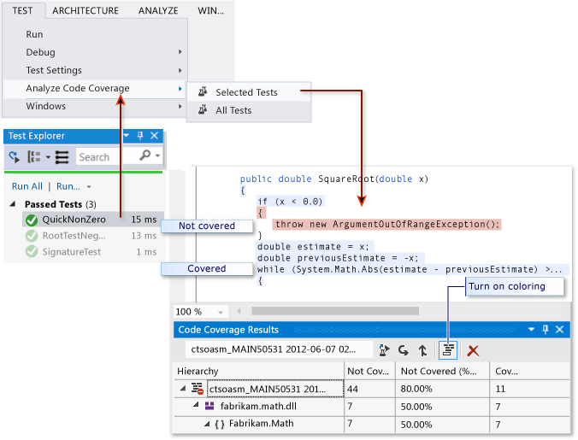
Coverage Support Tools
Visual Studio
https://msdn.microsoft.com/en-us/library/dd537628.aspx

Slide 27

Recap
White-box testing
Control Flow Graph (CFG)
Code Coverage
Statement
Branch
Path

